Slide 1
English 8-Chapter 8
Exercise 1
Identifying Sentence Fragments

Slide 2
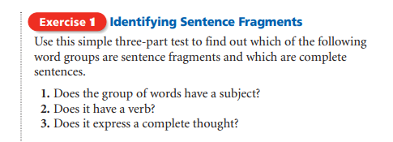

Slide 3
If the group of words is a complete sentence, Say S. If it is a fragment, Say F.

Slide 4
1.
Eleanor Roosevelt was First Lady of the United States from 1933 to 1945.

Slide 5
Eleanor Roosevelt was First Lady of the United States from 1933 to 1945.
S

Slide 6
2.
Raised by her grandmother because both of her parents had died by the time she was ten.

Slide 7
Raised by her grandmother because both of her parents had died by the time she was ten.
F

Slide 8
3.
Wrote a popular newspaper column entitled “My Day.”

Slide 9
Wrote a popular newspaper column entitled “My Day.”
F

Slide 10
4.
As First Lady, worked for the rights of the poor and underprivileged.

Slide 11
As First Lady, worked for the rights of the poor and underprivileged.
F

Slide 12
5.
Because she felt strongly about the struggles of children and minorities.

Slide 13
Because she felt strongly about the struggles of children and minorities.
F

Slide 14
6.
Eleanor Roosevelt traveled all over the world.

Slide 15
Eleanor Roosevelt traveled all over the world.
S

Slide 16
7.
Press conferences at which she discussed important issues.

Slide 17
Press conferences at which she discussed important issues.
F

Slide 18
8.
Important role in forming the United Nations. Important role in forming the United Nations.

Slide 19
Important role in forming the United Nations.
F

Slide 20
9.
Chairperson of the United Nations Commission on Human Rights.

Slide 21
Chairperson of the United Nations Commission on Human Rights.
F

Slide 22
10.
After a long life of public service, died in 1962.

Slide 23
After a long life of public service, died in 1962.
F

Slide 24
END!

